Slide 1

dfm_tools
A Python package for D-FlowFM input and output
Jelmer Veenstra

Slide 2

About myself
Studied Water Engineering and Management at University of Twente
Working as advisor/researcher hydrodynamics at Deltares since 2017
Department of Hydrodynamics and Forecasting
Development of hydrodynamic models (coastal/estuarian/global regions)
Python programming tools: making workflows generic and automate them

Slide 3


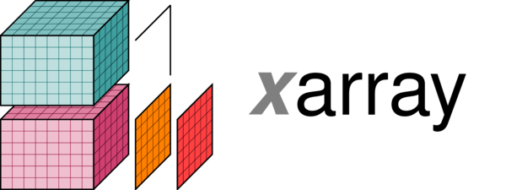




dfm_tools: the concept
What:
a Python package for pre- and postprocessing D-FlowFM input and output files
contains convenience functions built on top of other packages like xarray, xugrid, HYDROLIB-core, MeshkernelPy and many more
sharing of workflows among users (colleagues/external)
no need to re-invent the wheel
Where:
code on github: https://github.com/Deltares/dfm_tools
installable via pip
jupyter notebooks and binder with example code

Slide 4
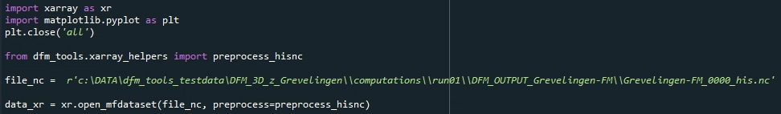
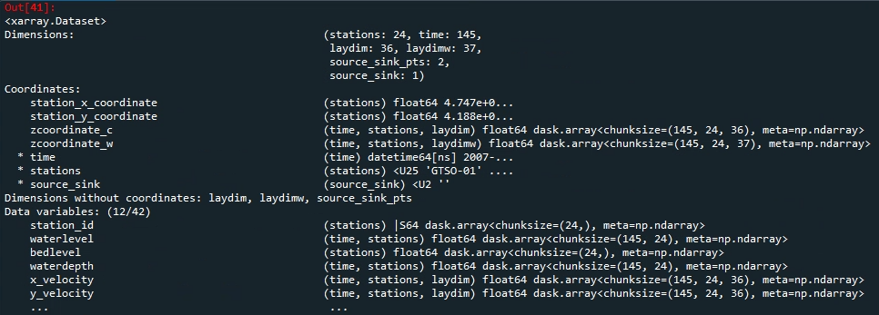
xarray: io of netcdf files
lazy loading of netcdf files with knowledge of the entire structure
easy indexing over all dimensions with .isel() and .sel()
preprocess_his() enables indexing via station names (and other labels)

Slide 5
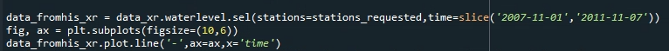
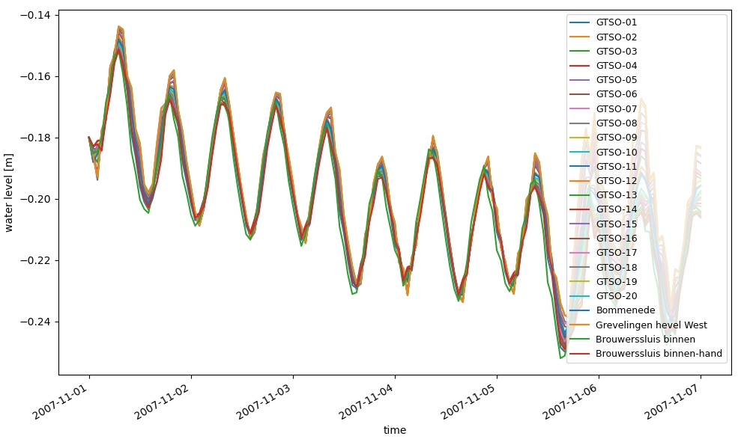
xarray: plotting of netcdf files
easy indexing (subsetting)
easy and complete plotting

Slide 6
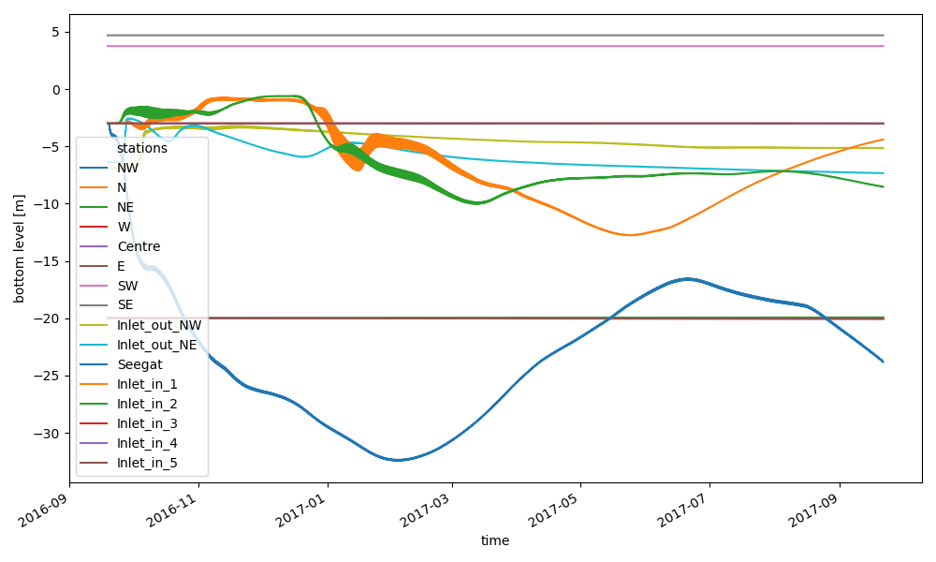
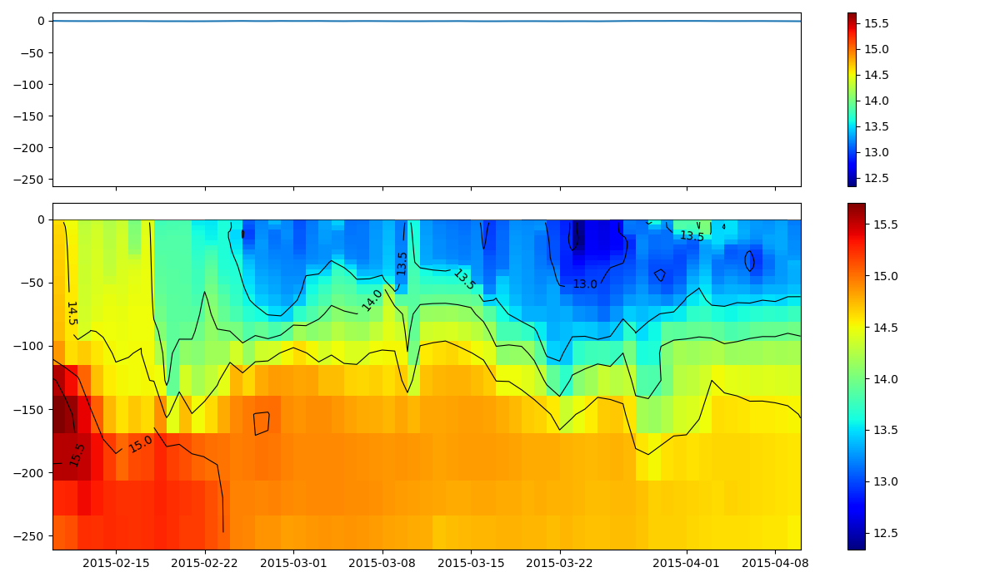
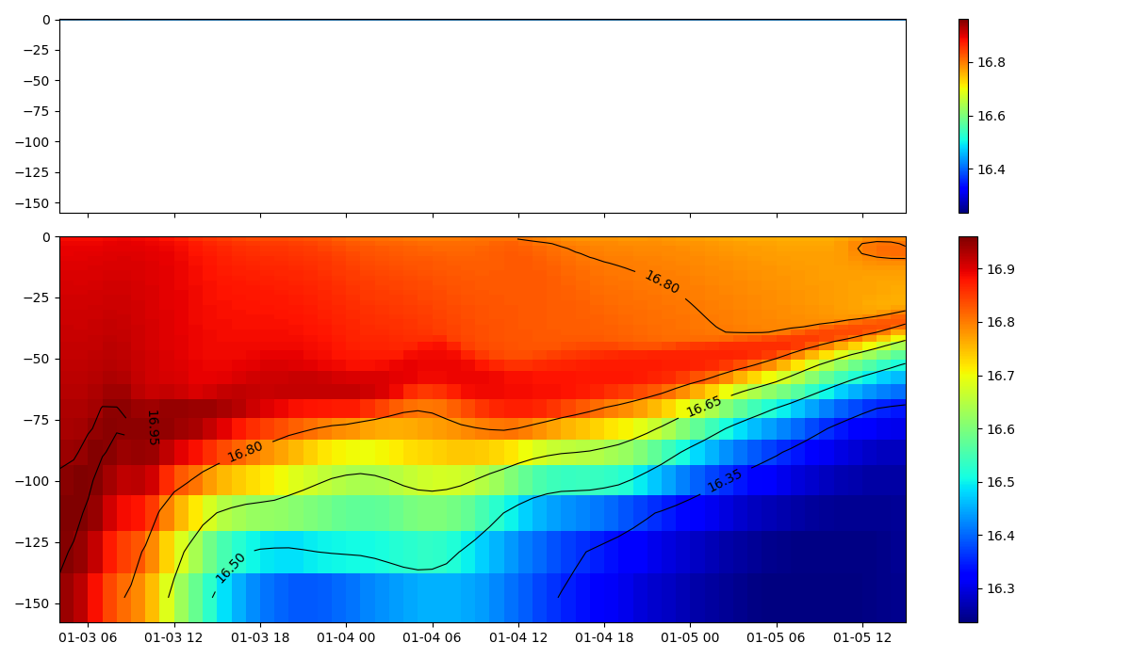
Examples: read+plot hisfile
xarray for reading D-FlowFM hisfile
easy subsetting on stations, cross_sections, general structures, etc thanks to dfmt.preprocess_hisnc()
selection of data over dimensions: time, depth, stations, cross_sections, structures, etc
zt-plot (timeseries of one point incl. depth)

Slide 7
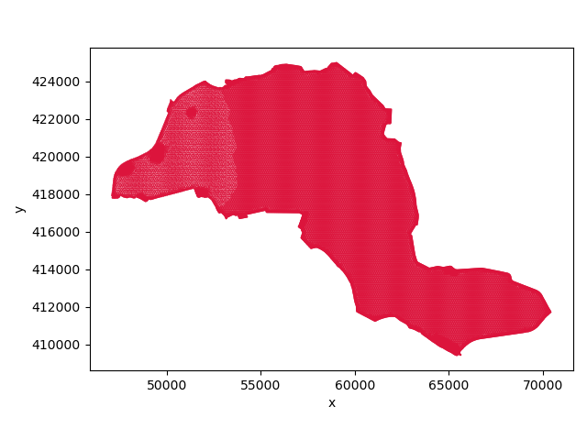
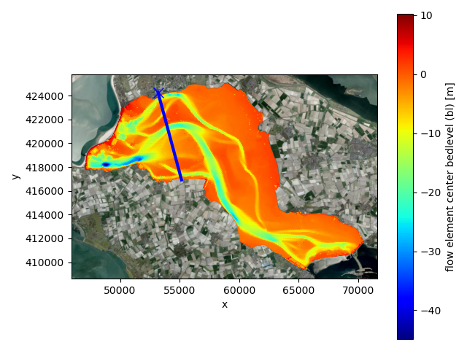
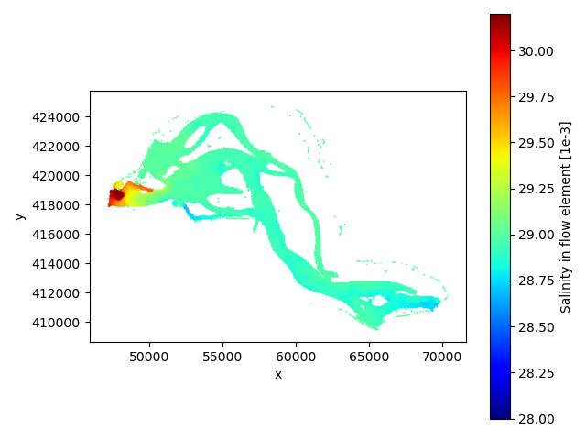
Examples: read+plot mapfiles
xarray/xugrid for reading D-FlowFM (unstructured) map/fou/rst/net files
supports partitions (handling of ghost cells)
select data based on variable and dimensions (time/layer/etc)
satellite backgrounds with contextily

Slide 8
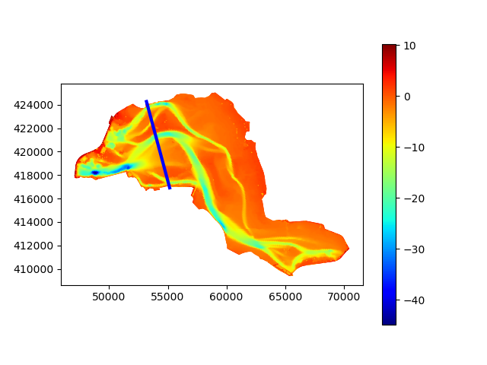
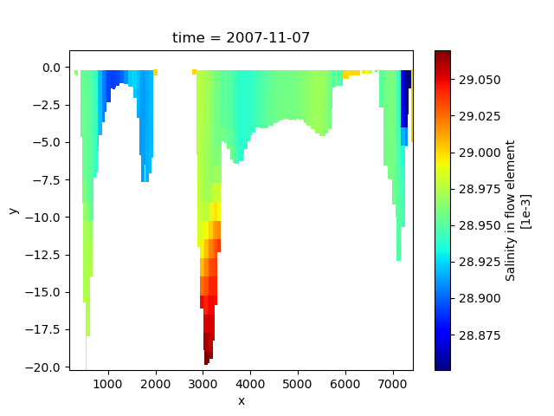
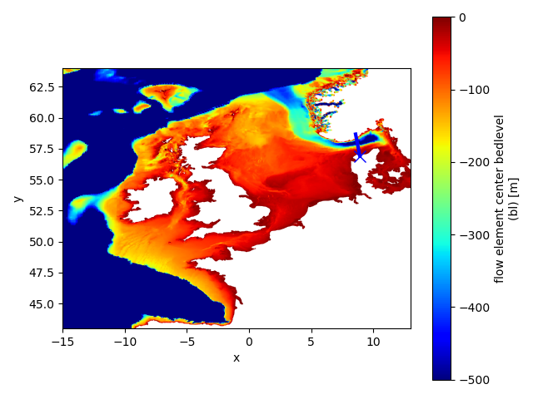
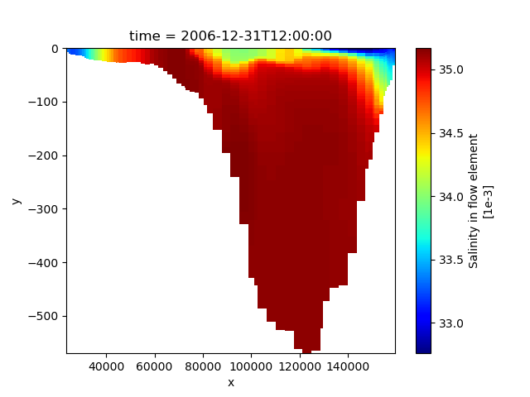
Examples: cross section trough 3D partitioned FM map data
given a polyline (blue)
slice trough 3D partitioned FM map data

Slide 9
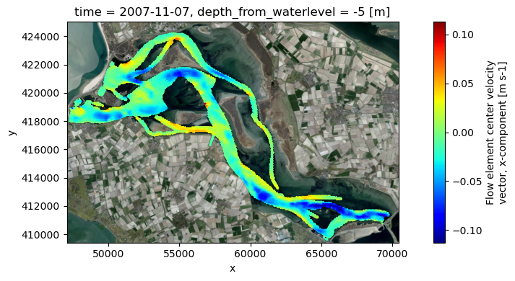
Examples: slice trough 3D partitioned FM map data
given a depth w.r.t. z0, waterlevel, bedlevel
slice trough 3D partitioned FM map data
support for sigma, z and zsigma layers

Slide 10
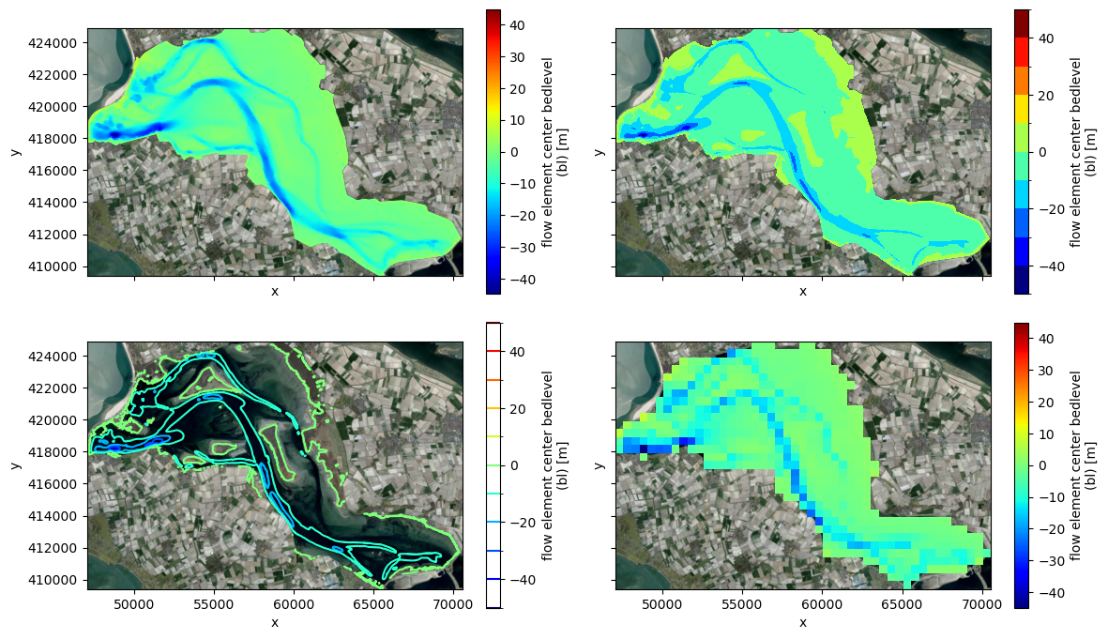
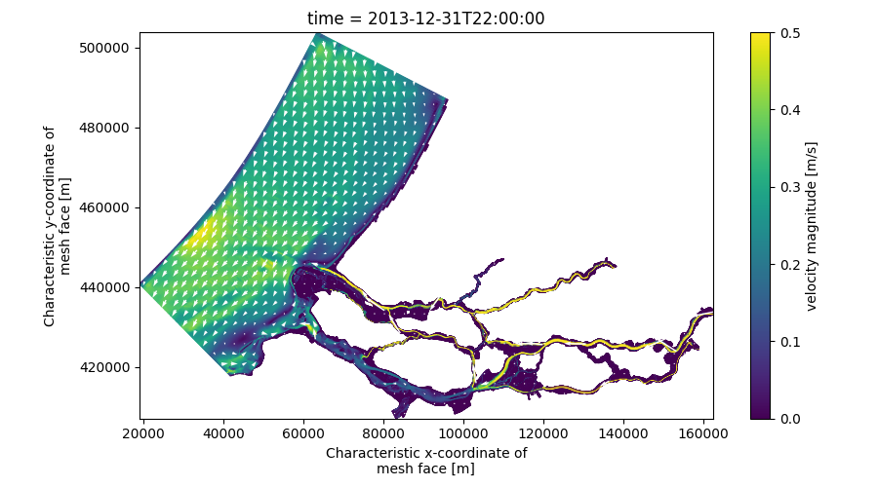
Examples: various plotting options
Easy to create fancier plots like contourf or contour
Rasterization to regular gridded dataset for e.g. different-grid comparisons
More examples in the xugrid docs
Other xugrid features: selection, interpolation, regridding, reindex_like and many more

Slide 11
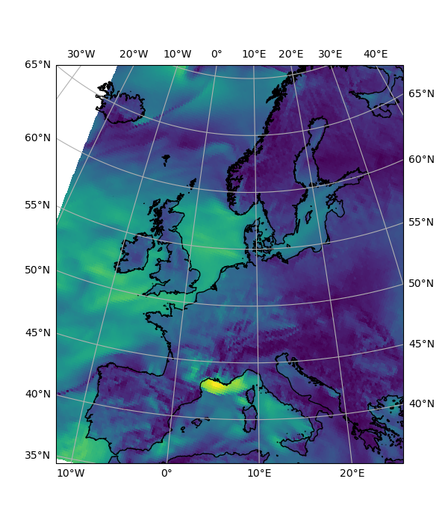
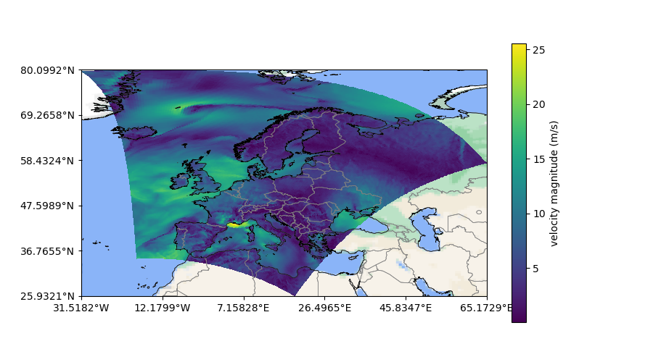
Examples: cartopy basemaps and coastlines/borders
support for almost any epsg

Slide 12
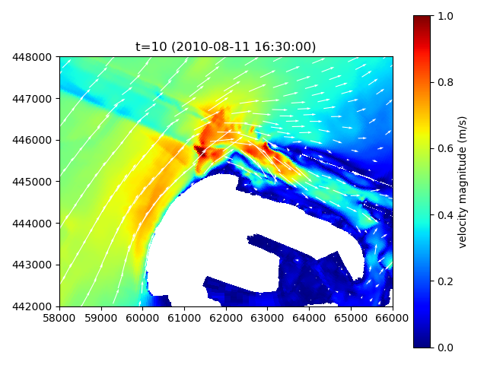
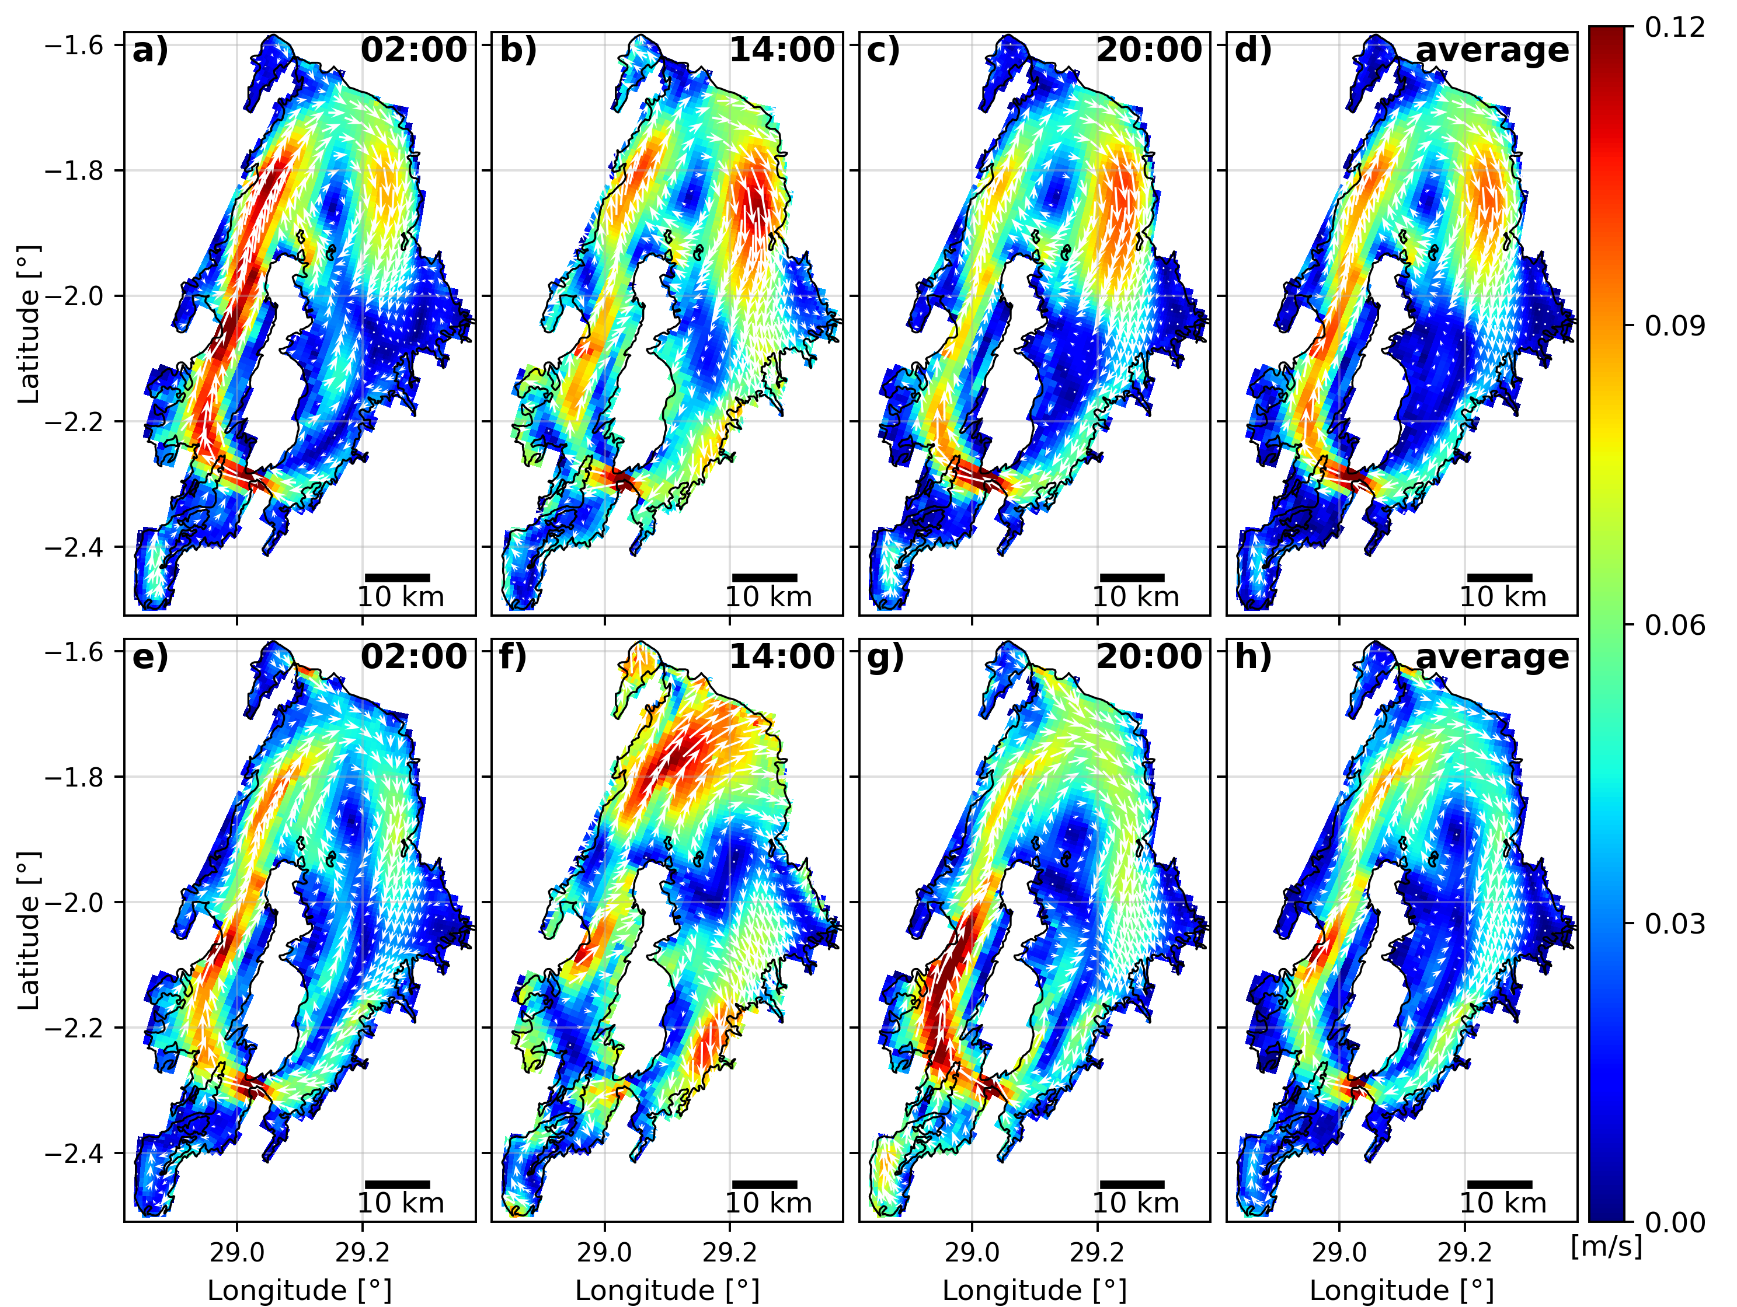
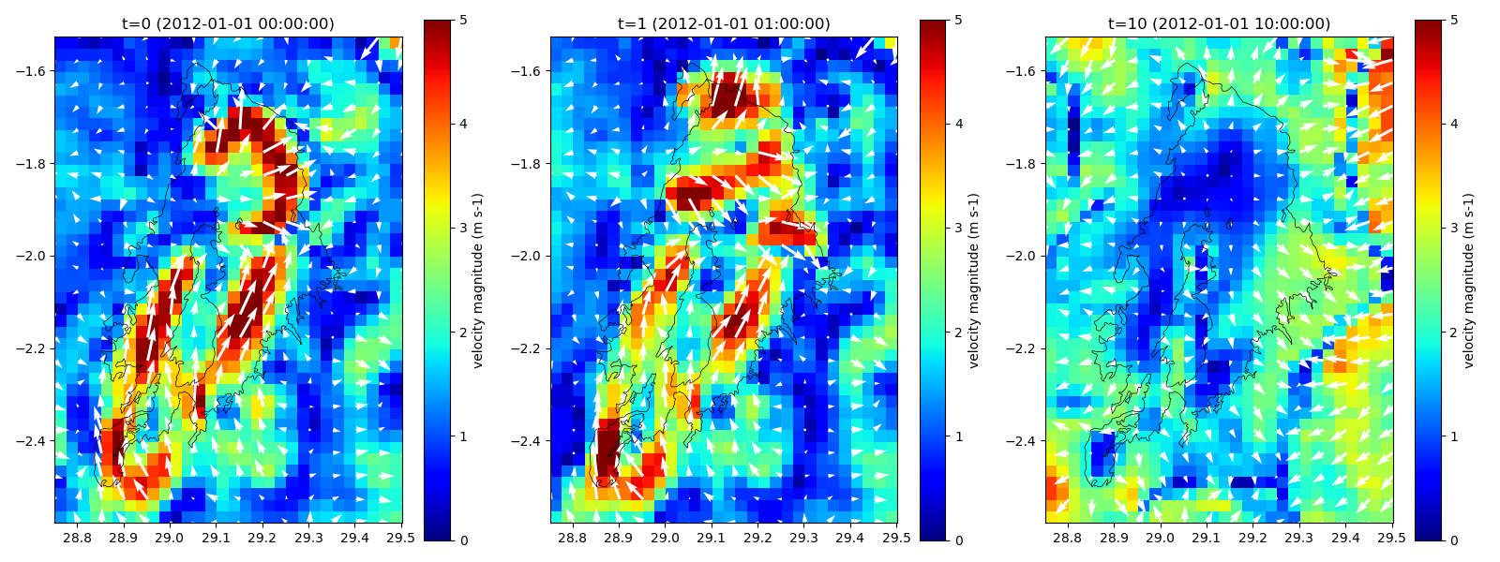
Examples: vector plots for regulargrids
support for any other netCDF
e.g.: SFINCS, Delft3D4, oceanmodels, meteomodels

Slide 13

HYDROLIB-core: io of D-FlowFM input files
Core scripts & tools for interaction with D-FlowFM:
reading/writing of (almost all) D-FlowFM input files (mdu, ext, bc, pli, etc)
full functionalities: https://deltares.github.io/HYDROLIB-core/0.3.1/topics/dhydro_support/
supported, documented, maintained
available on github: https://github.com/Deltares/HYDROLIB-core
users do not need to re-invent the wheel about “basic stuff/file formats”, focus on the analysis itself

Slide 14
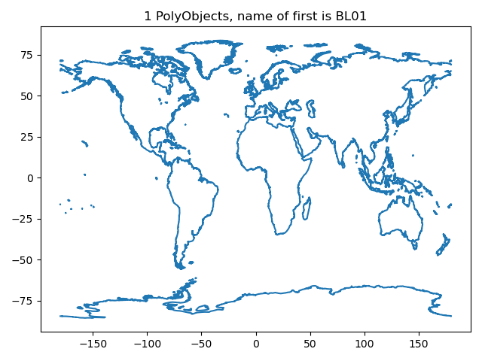
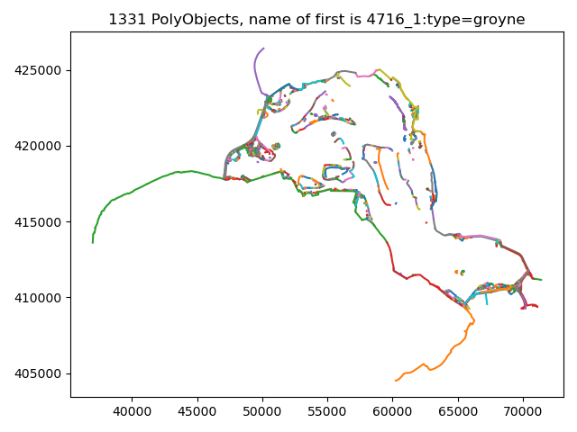
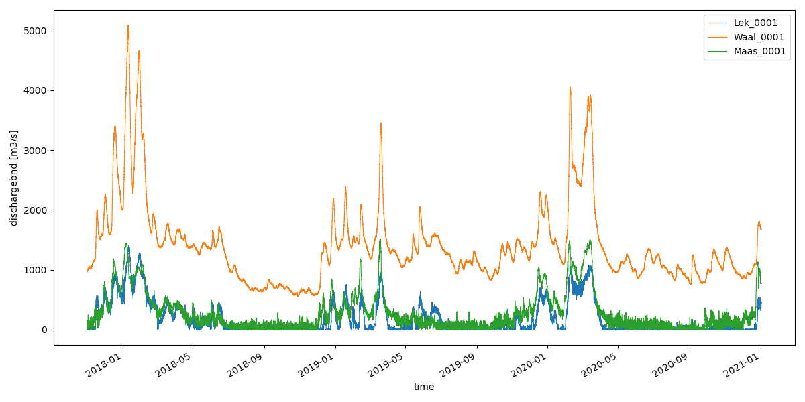
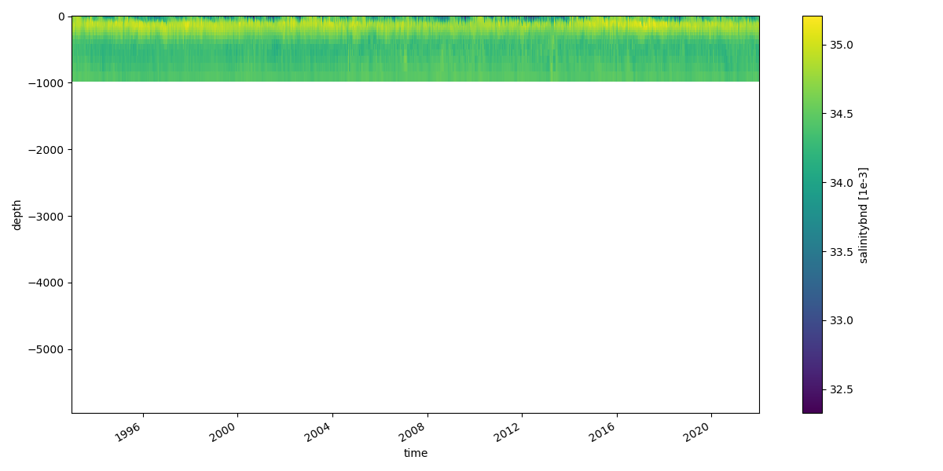
Examples: reading + plotting of D-FlowFM input files
HYDROLIB-core for reading files
conversion to xarray/pandas datasets with dfm_tools
figures: pli/pliz/ldb/tek and bc files

Slide 15
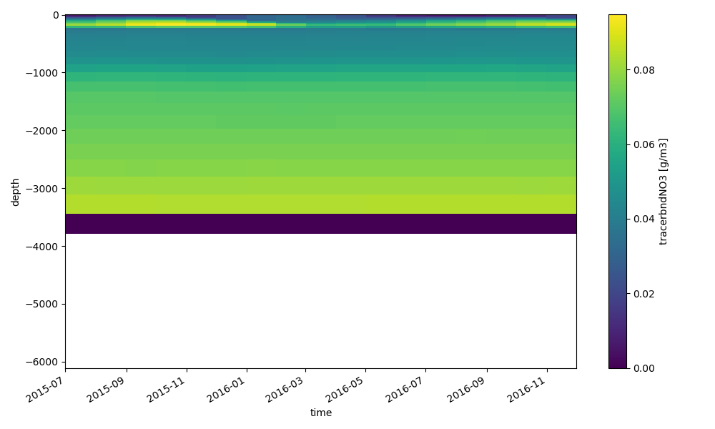
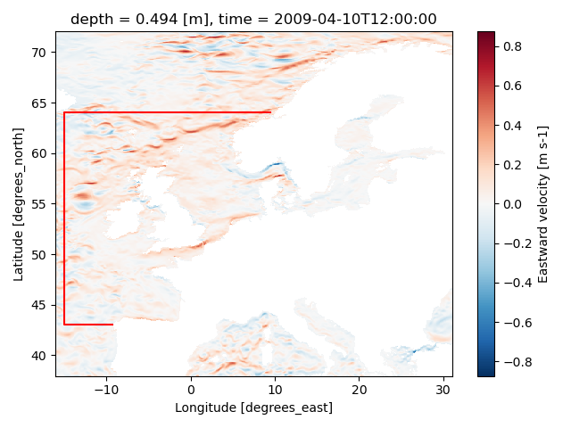
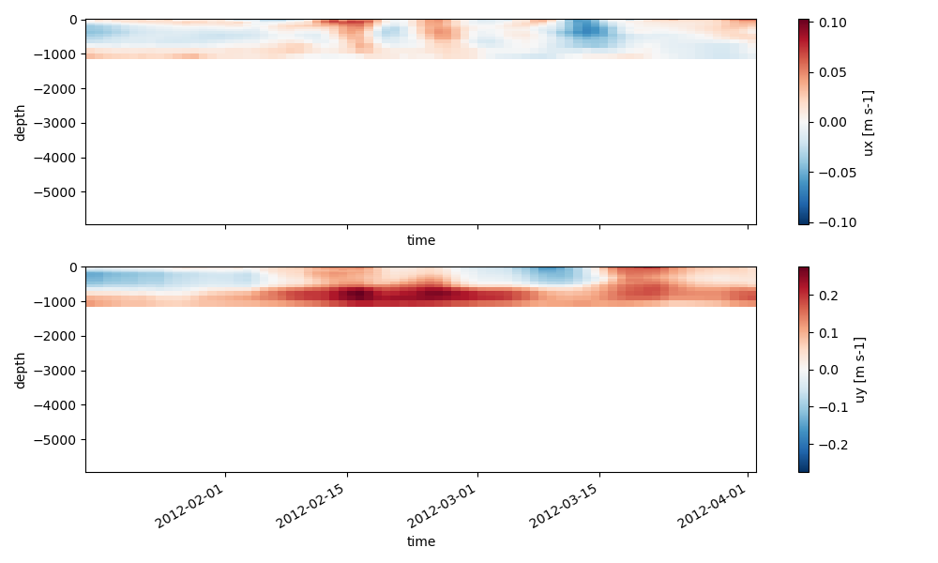
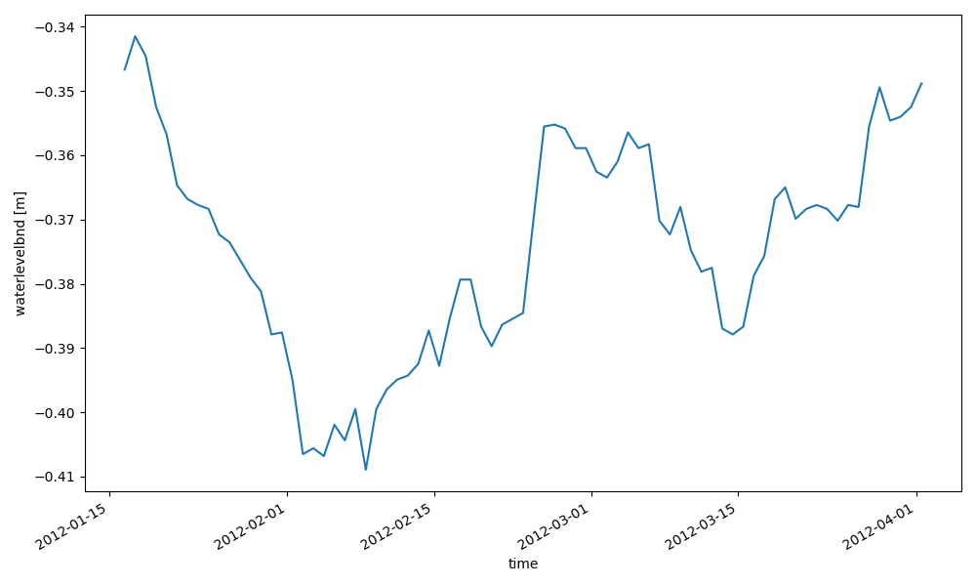
Examples: interpolate oceanmodel to bc
xarray for reading netcdf data and .interp() to polyline points
HYDROLIB-core for reading polyline and writing bc/ext files

Slide 16
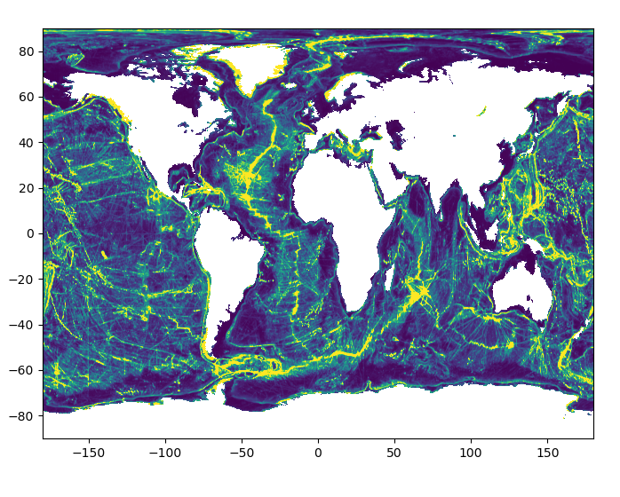
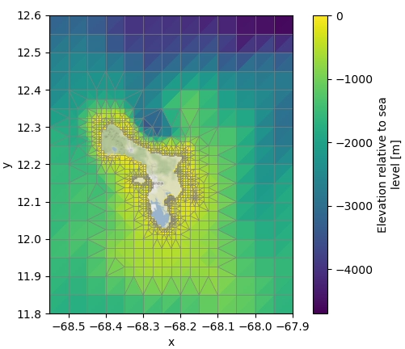
Recent developments
grid generation + refinement based on bathymetry/waterdepth with MeshkernelPy
usage of xarray in dfm_tools: merging+interpolation of model forcing
development of 2D3D functionality in HYDROLIB-core
BES hackaton: combining above into a modelbuilder “proof of concept”
Notes:
BES: Bonaire, st Eustacius, Saba

Slide 17
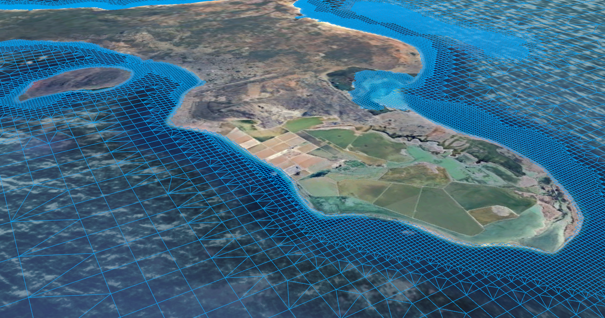
Combined into 3D Model Builder
Based on bounding box and period of interest, a 3D D-Flow FM model is created from global datasets:
Using Python libraries HYDROLIB-core, dfm_tools, MeshKernelPy, xarray and others
Grid generation and refinement (based on local water depth)
Bathymetry (GEBCO) retrieval and interpolation to grid
Initial and open boundary conditions: download and interpolate ocean currents, sea surface heights, salinity, temperature from CMEMS or others, tide from FES2014, EOT or GTSMv4.1
Meteorological forcing: download ERA5

